Slide 1
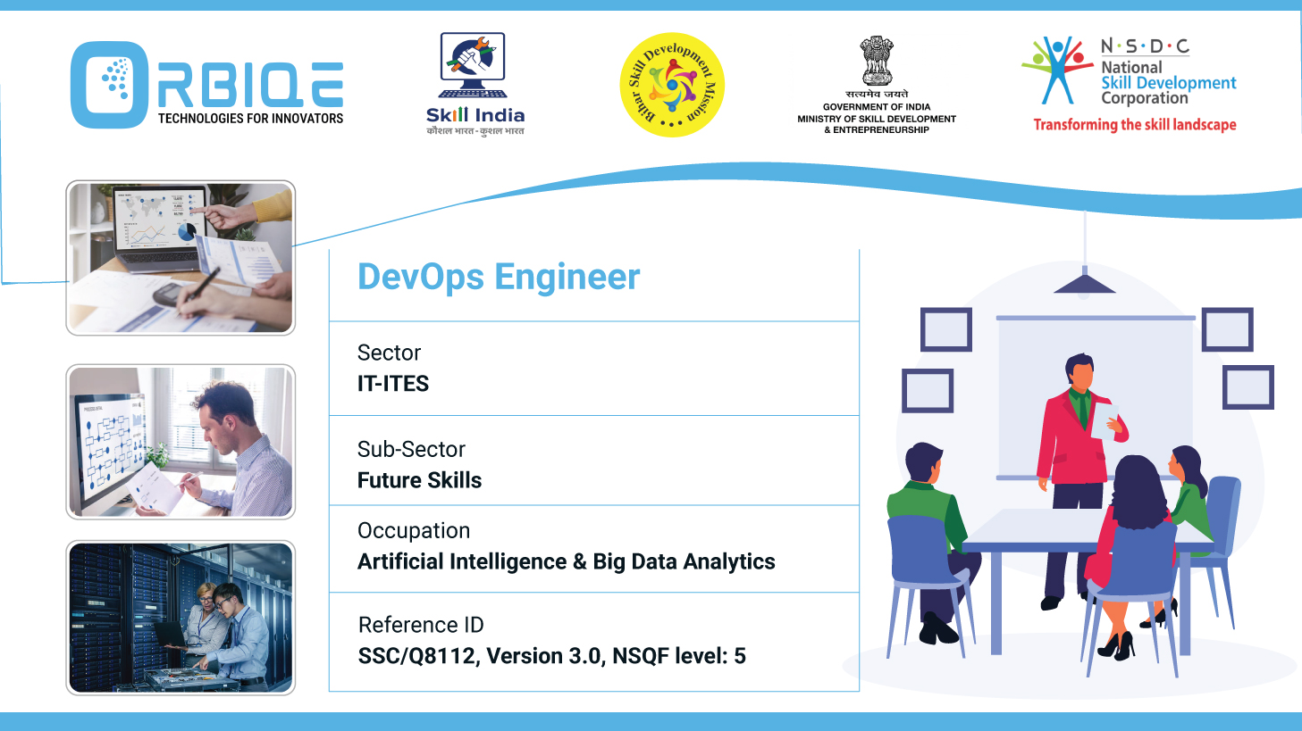
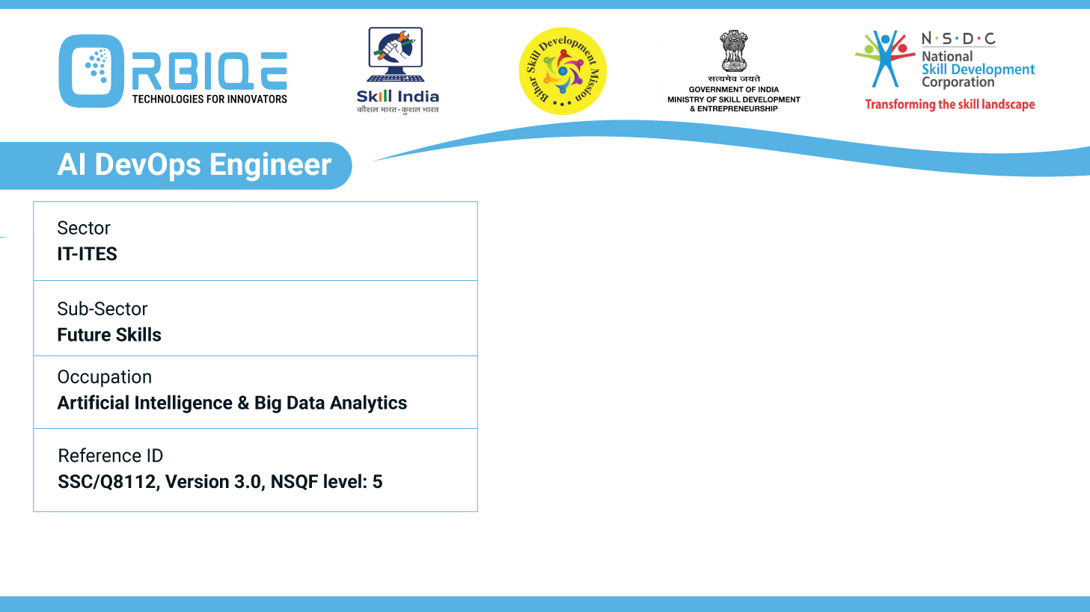
Name- Krishna Kant Dubey

Slide 2

Overview of Administration Tools and Usage

Slide 3
Agenda
Distinguish between different data administration tools, frameworks and microservices
Explain the basics of different infrastructure components such as storage devices, networking hardware, server storage connectivity, virtualization technologies
Understanding the applications and limitations of various components like computing platforms, microservices, frameworks, libraries, and tools is crucial for understanding their suitability and potential challenges in software development.

Slide 4
Distinguish between different data administration tools, frameworks and microservices
Data administration tools
Frameworks
Microservices

Slide 5
Different infrastructure components
Storage devices
Networking hardware
Server storage connectivity
Virtualization technologies

Slide 6
Applications and limitations of various components
Computing platforms
Microservices
Frameworks
Libraries
Tools

Slide 7
Thank You

